Slide 1

Los Angeles, California Crime data (2010-2019)
Emanuel Calderon, Jiayuan Ai, Jonathan Huck, Monika Malik and Zalan Mumtaz
LAPD Seal
Notes:
LAPD Seal

Slide 2
AGENDA
Objective and Exploration
Trends in the Data
Problem Statement
Benefits of a Predictive Model
Business Value
SEMMA
1. Sample - Pick only solved Crimes Data
2. Missing Values and Outliers
3. Summary Statistics of Columns
4. Modify the Data (Categories and Indicator Columns)
5. Partitioning the Data
6. Models
1. Predictor Screening
2. PCA
3. Models 1,2,3
4. Assess
5. Conclusion
7. Additional Models

Slide 3
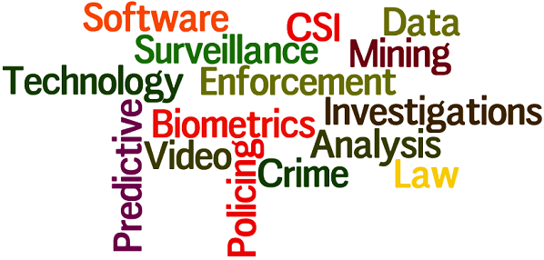
Objective & Exploration
Predictive analytics will assist the LA Police department forecast future outcomes based on historical data and analytic techniques. This will generate future insights with a significant degree of precision. With analytics, the LA police can find and exploit patterns within the data in order to detect risks and opportunities. This will guide informed decision-making across all crime areas. Specifically, the LAPD will be able to predict if crimes were created by a Juvenile or an adult & create an understanding of correlations between crime categories.

Slide 4
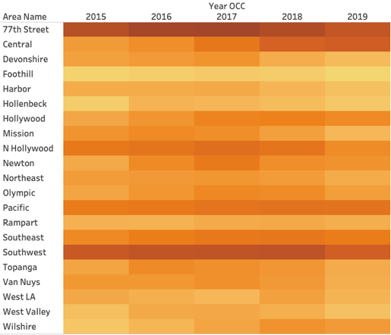
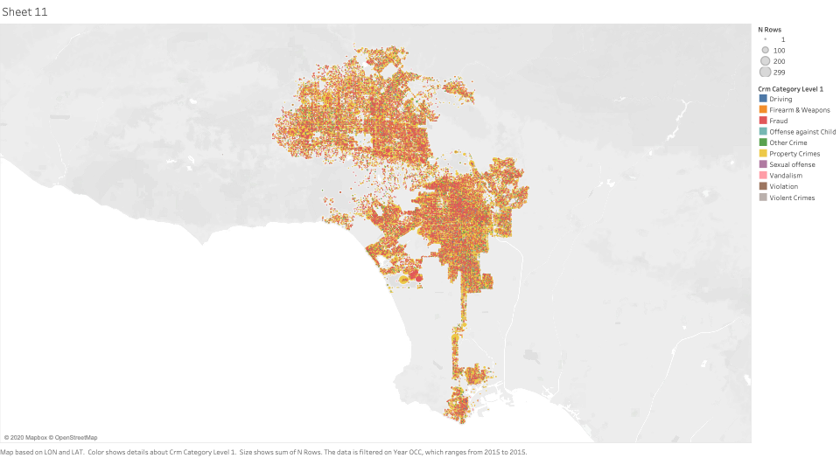
Trends in the Data Set
Incidents of crime in the City of Los Angeles, California from 2010-2019
Data is transcribed from original reports
2.11 million cases
Police Siren

Slide 5

Problem Statement
Crime in America is the second leading cause of death among youths. Los Angeles has the third highest crime rates in the nation directly affecting four million youth in the city. The LA Police precinct require swift responses to crime issues & reasons for these occurrences.
http://www.lapdonline.org/home/content_basic_view/23514

Slide 6
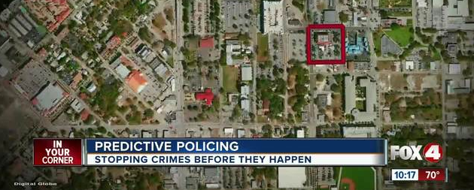
Benefits of a LA Crime Predictive Model
Through research, the models will assist police in recognizing recurring issues and respective outcomes related to juveniles.
A policy response step enables police to use their research from the analysis step to brainstorm ideas for intervention, outline plans and objectives, and implement proposed plans.
https://www.fox4now.com/news/police-using-analytics-to-predict-crime

Slide 7


Business Value
The LAPD will be able to strategize their approach of proactively reducing amount of crimes occurred and keeping communities safer, given the teams predictive model.
Reduction in labor costs associated to patrolling, incoming calls and other factors by focusing more on crime hot spots. Decrease in response time of calls made. Develop measurable activities to monitor reduction in crimes among youths.

Slide 8
SEMMA Approach
SEMMA (Sample, Explore, Modify, Model, and Assess) is a list of sequential steps developed by SAS Institute, one of the largest producers of statistics and business intelligence software.
Step 1: Sample the Data
Step 2: Explore
Step 3: Modify
Step 4: Model
Step 5: Assess
This data mining process is what the team used during the research of the LAPD crime data.
Where team spent most time

Slide 9
Step 1: Sample the Data
For this step, the data set should be large enough to contain sufficient information and small enough to be efficiently used.
In our project, we began with ~2 million rows of 28 variables. The length of data was attributed to how many crimes have occurred from 2019 back to 2010.
Last sampled data consisted of 297,000 data entries, with 36 variables, dates ranging from 2019-2015 and all involved solved crimes only.
Gave meaningful predictive modeling on few variables rather than none

Slide 10
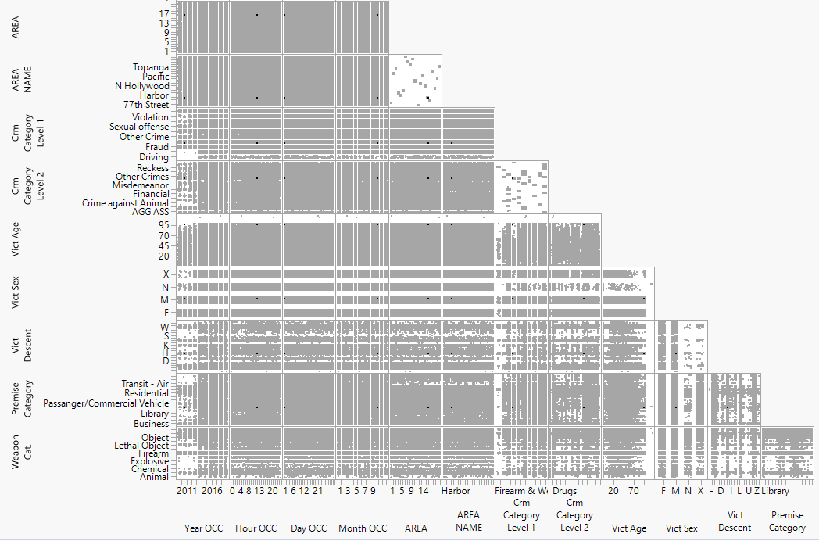
Step 2: Explore
Understanding the data by discovering anticipated and unanticipated relationships.

Slide 11
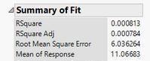
Interesting Discoveries
Variability in multiple locations of Los Angeles
No Structural breaks in time series process
Bias in data considered to be inconclusive
Males in mid-twenties carry a higher weight in the forecasting model.
Exploration of data revealed a RMSE of 6.04 (>.5 is related to a poor predictive model or not significant) see the below figure

Slide 12
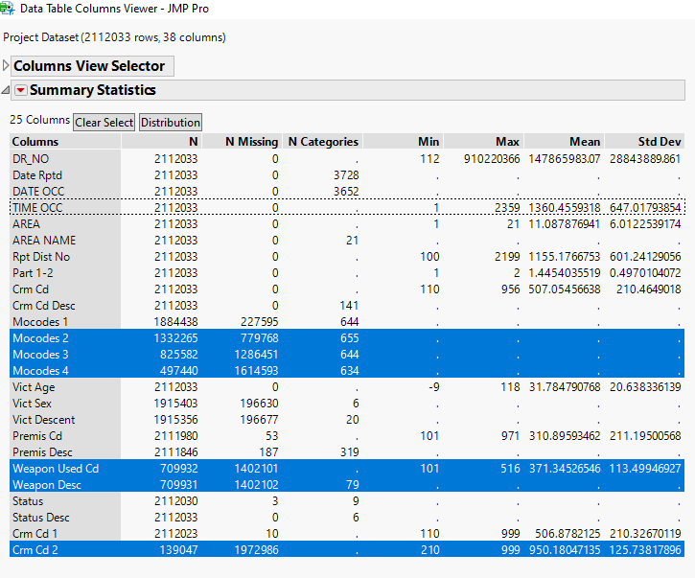
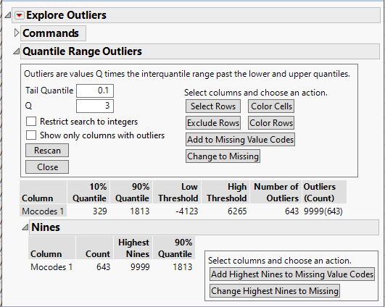
Missing Values & Outliers
Due to Jmp’s missing values and outlier listings, team was able to identify several ways to improve sample:
Initially clean data
Ignore unhelpful data
Ignore redundant data
Understand most variables are categorical
Disregard potential high yielding predictor RMSE’s

Slide 13
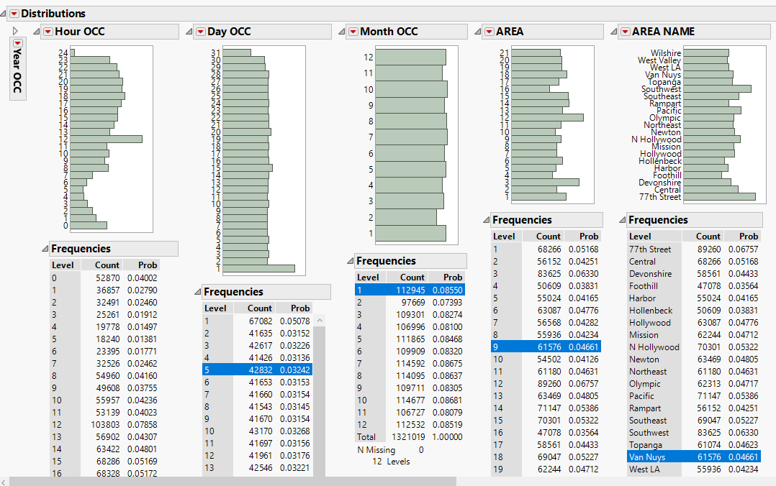
Column Summary Statistics

Slide 14
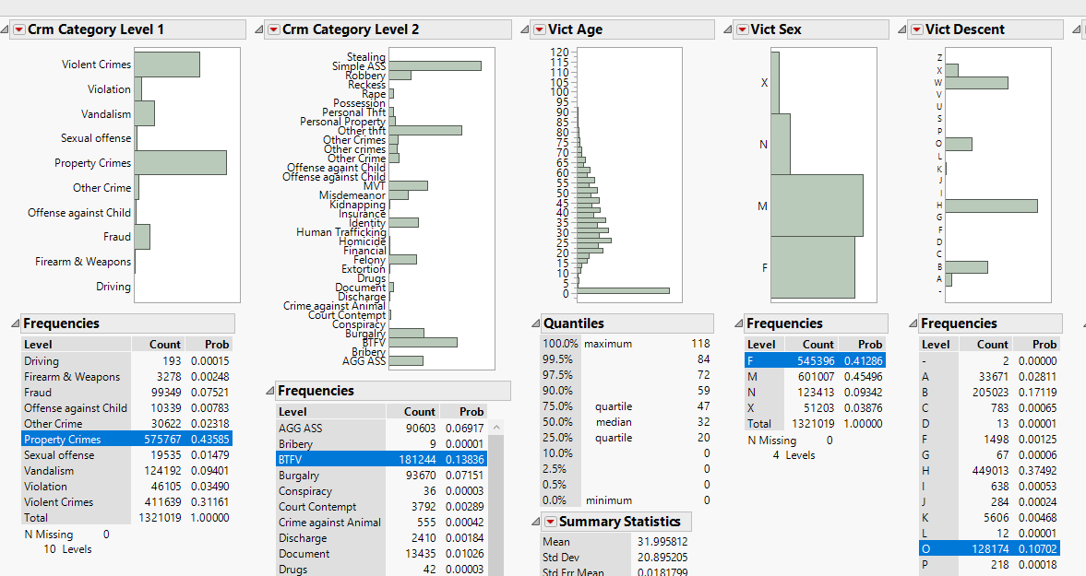
Column Summary Statistics (cont...)

Slide 15
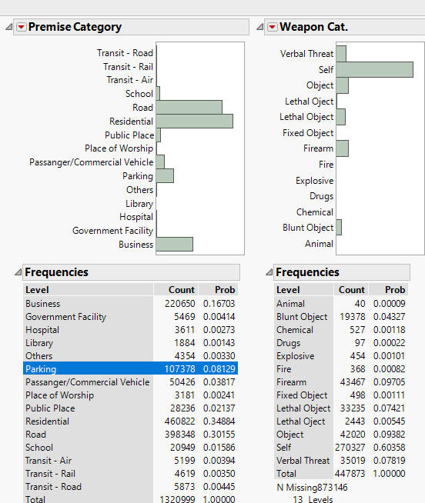
Column Summary Statistics (cont...)

Slide 16
Step 3: Modify
The Modify phase contains methods to select, create and transform variables in preparation for data modeling. There were many modifications made in order to get a better trend and predictive capability. Listed below are the data tweaks made to respective variables:
Date of Occurrence
Data type changed
Separated time/day/month/year (4 new columns)
Crime Code Description
Items bucketed in category levels
Descriptions made broader (2 new columns)
Premise Description
Descriptions made broader (1 new column)
Weapon Description
descriptions made broader (1 new column)
Status Description
Whether adult or juvenile (2 columns)

Slide 17
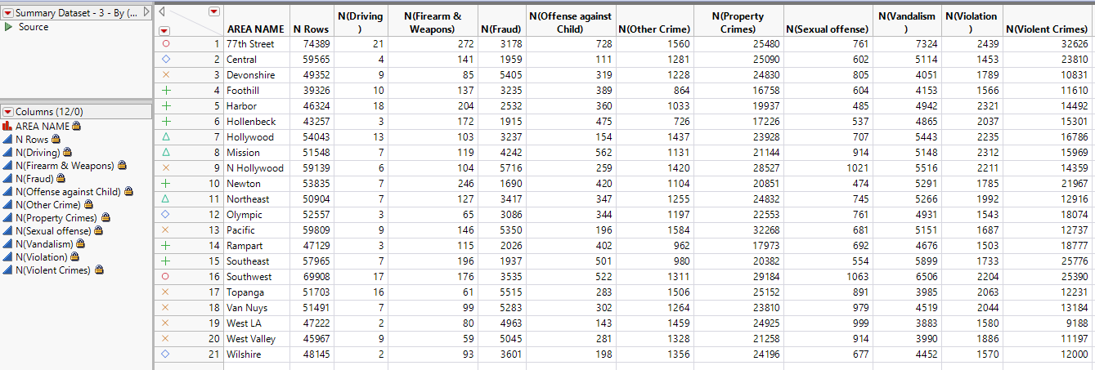
Modification of Sample
Dsfssdfsdfdfsdfdsdfsdfsdfsdf
Data was transformed to continuous variables
Created summary data sets to create crime hot spots and cluster regions
Create time series modeling to predict number of crimes in 2020

Slide 18
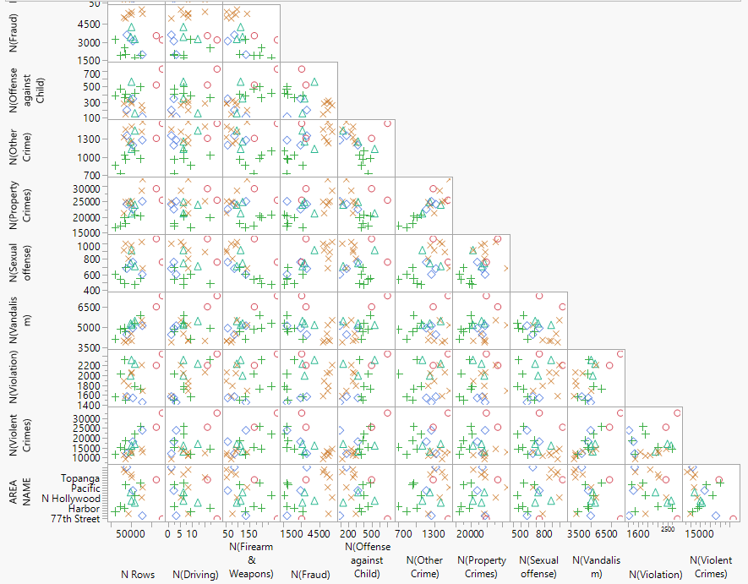
Modification of Sample (cont..)

Slide 19
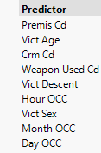
Last Modification
Last sampled data consisted of 297,000 data entries, with 36 variables, dates ranging from 2019-2015 and all involved solved crimes only.
With above data, the team was better able to provide a predictive outcome for business case

Slide 20
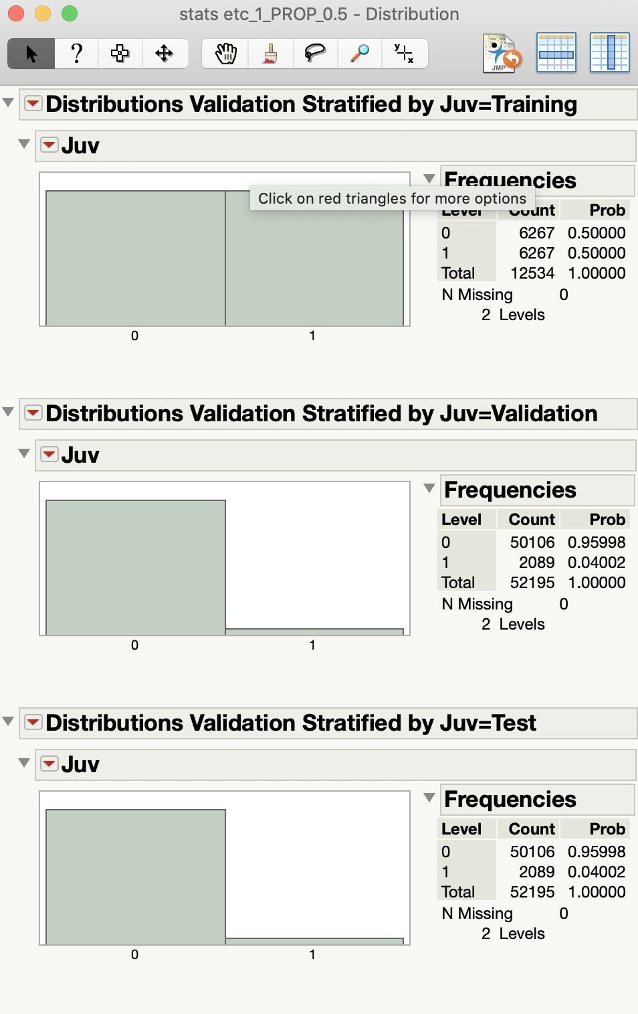
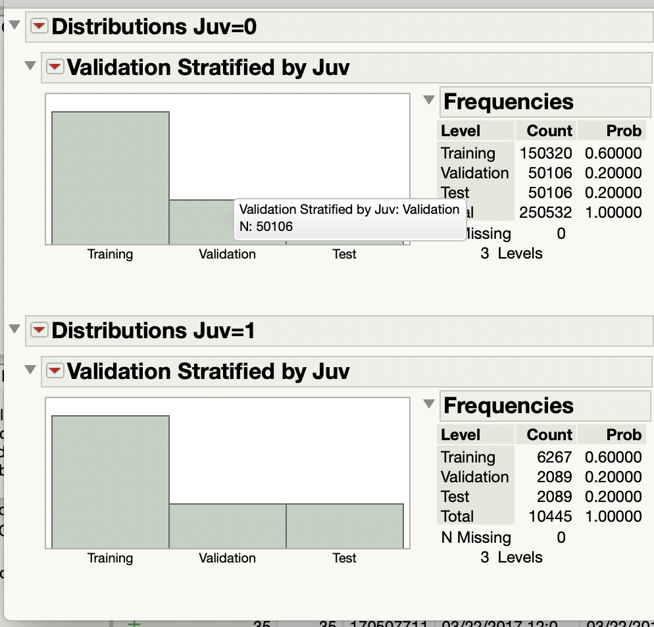
Create Training, validation and test data
Using stratified split balanced by juvenile
with 1 as focal group with number of 1s that are lowest (juvenile)
Notes:
coz the number of 1's in our data is very less in proportion
to make sure our model is able to train , we need to stratify to increase 1's in data

Slide 21
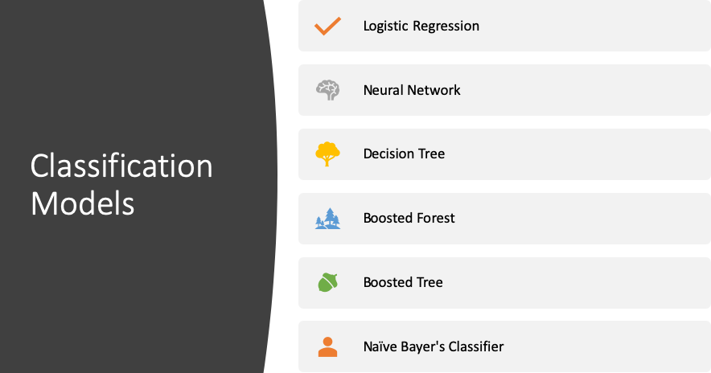

Slide 22
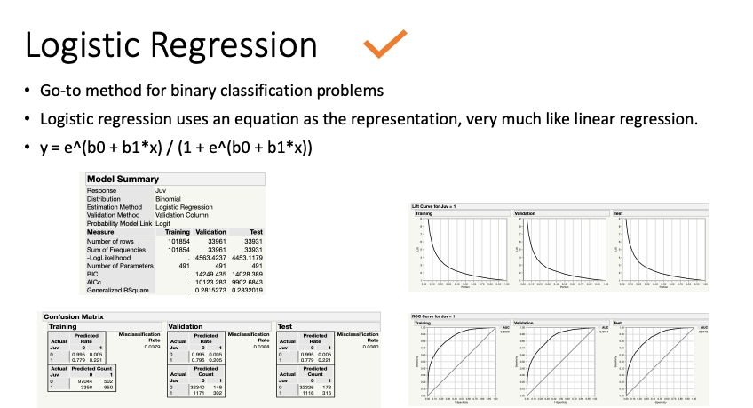

Slide 23
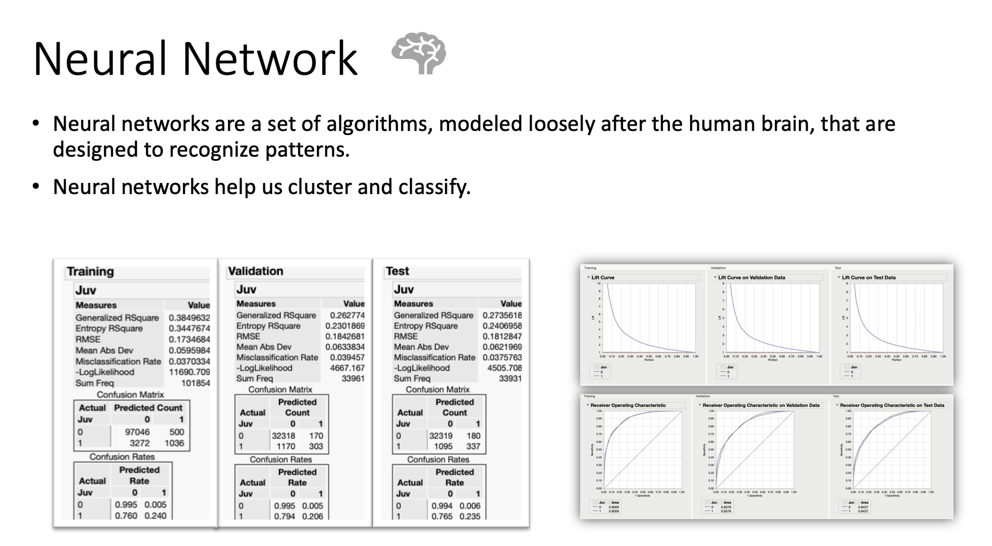

Slide 24
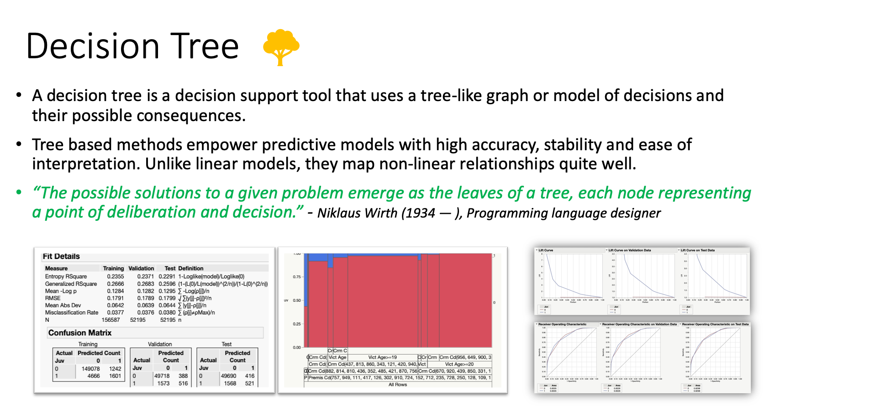

Slide 25
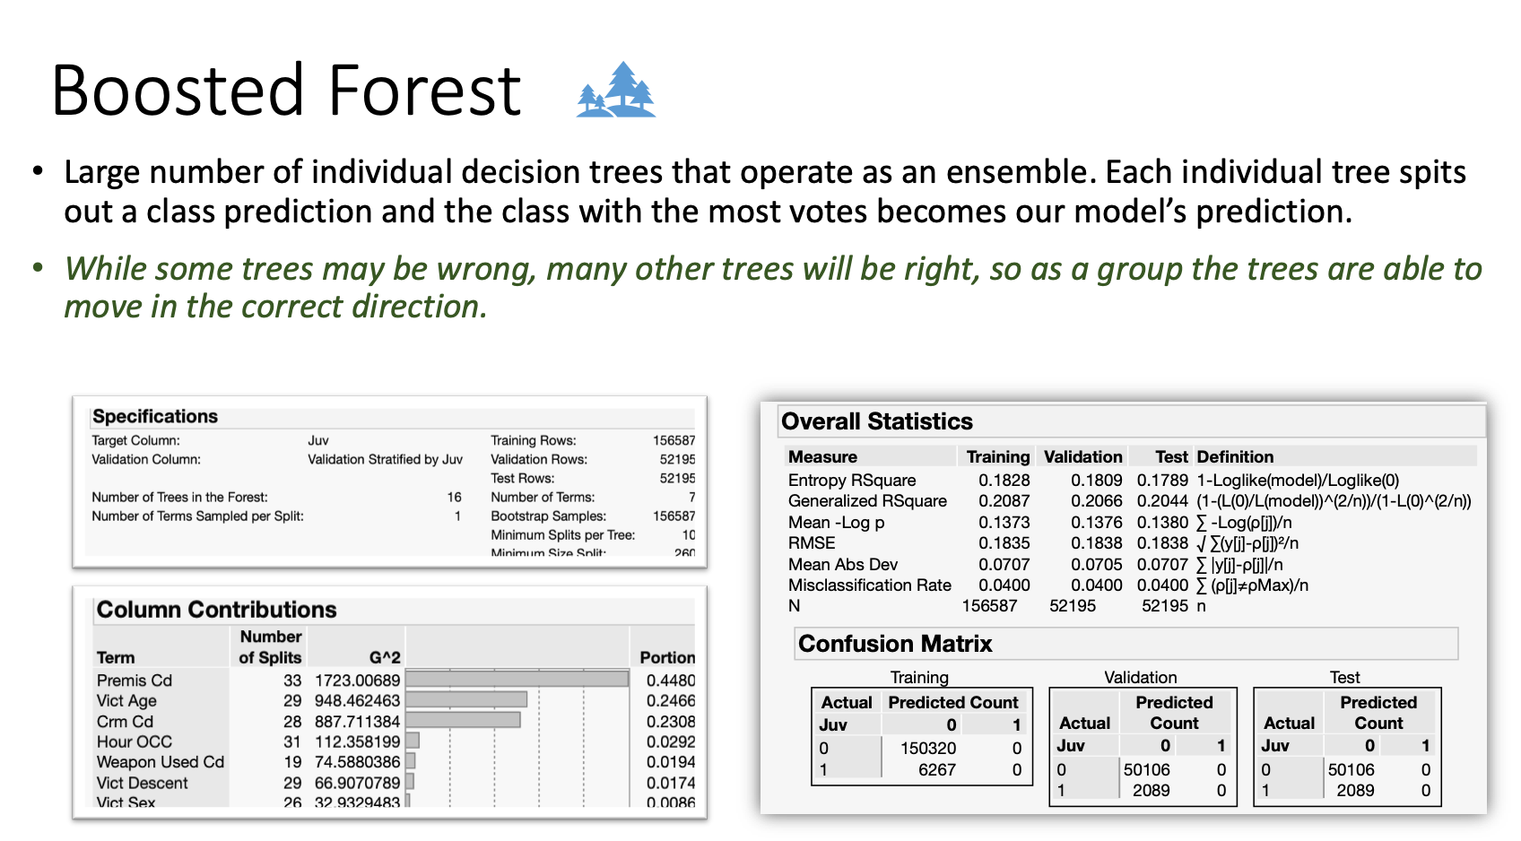

Slide 26
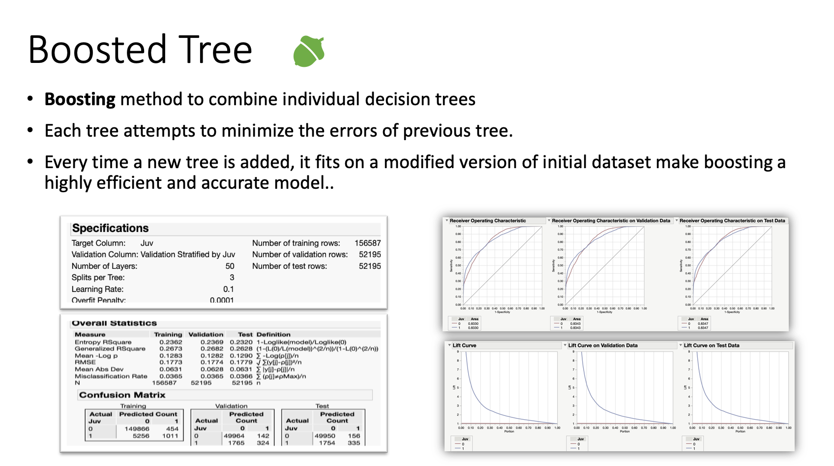

Slide 27
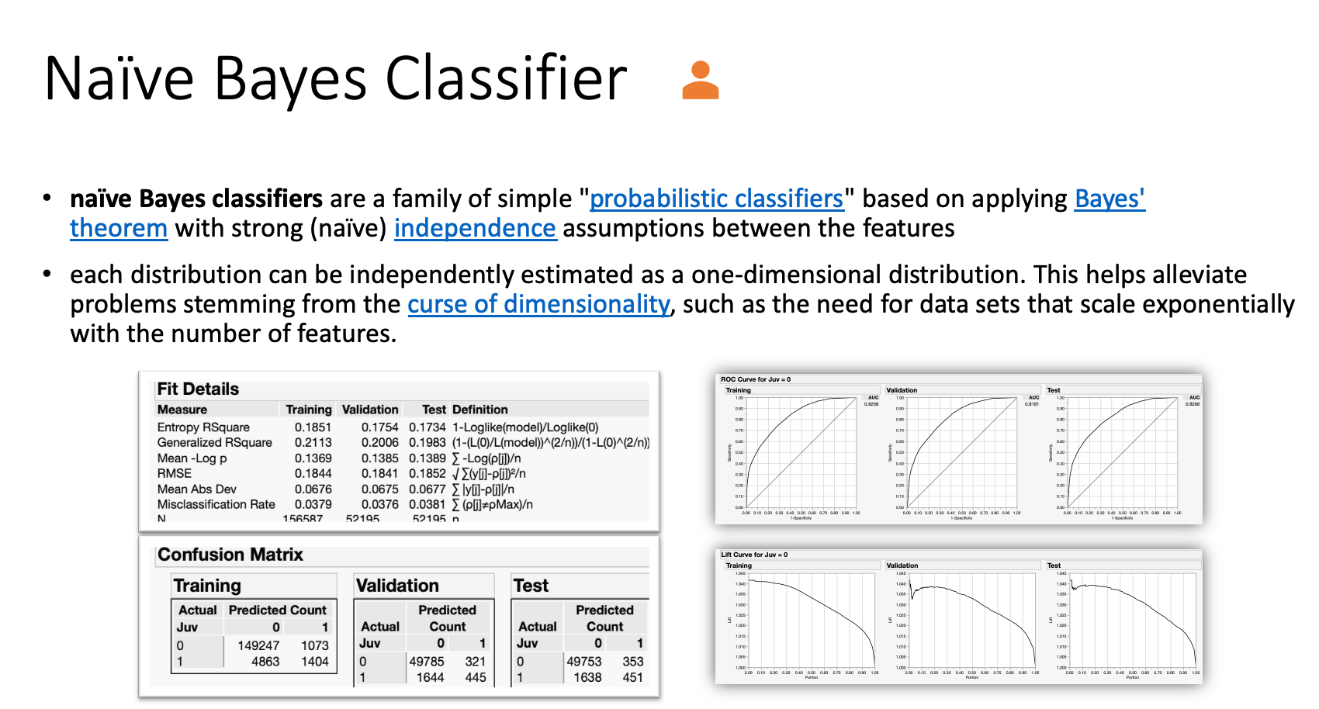

Slide 28
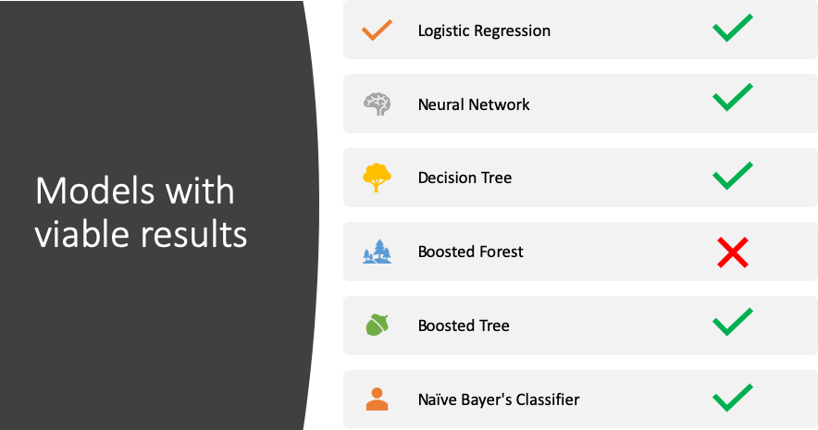

Slide 29
Model Evaluation Considerations
Based on Confusion Matrix - Accuracy/Classification error
Based on ROC - Area under the ROC curve (AUC)
All misclassifications cannot be equally considered
Data Overfitting
Interest in minimizing the expected cost of classification error

Slide 30
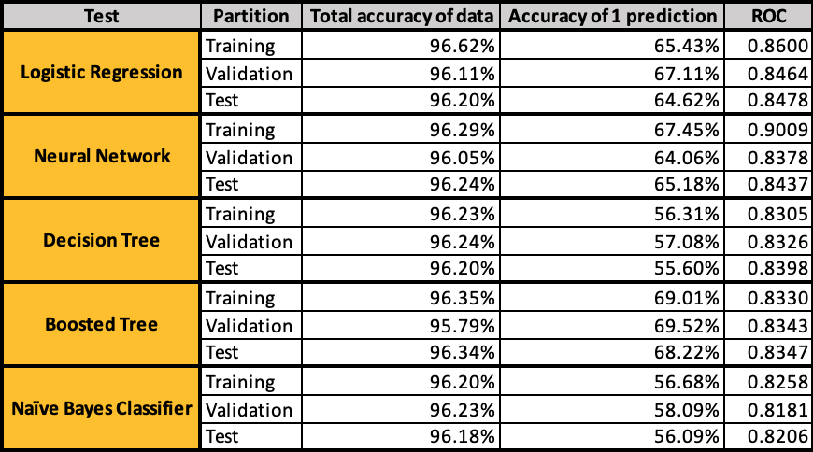
Assessing the Models

Slide 31
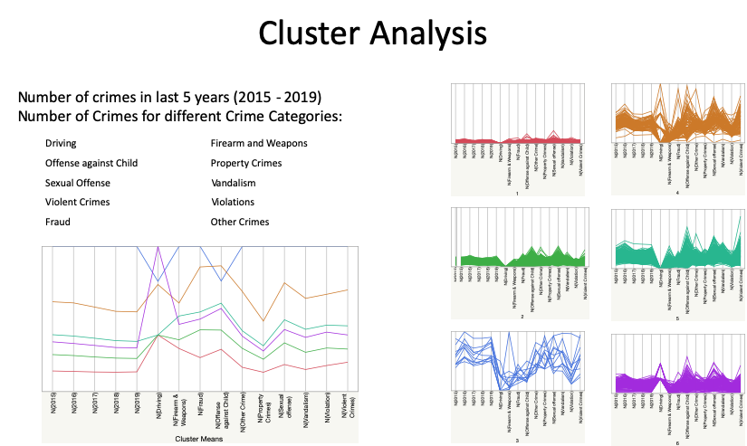

Slide 32
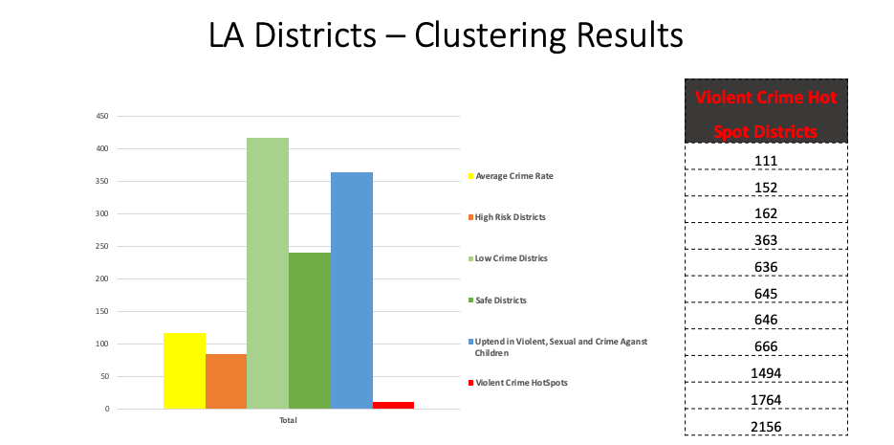
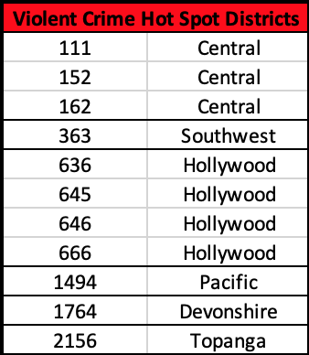
LA Districts – Clustering Results

Slide 33
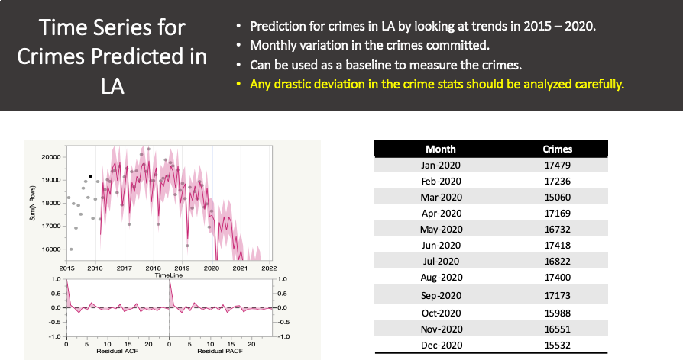

Slide 34

Conclusion
Limited the number of predictors to 7 to reduce the complexity.
Crime data is highly unpredictable and needs to be enhanced by Subject Matter Experts and supplemental datasets.
11 Violent Crime Hot spots districts determined in LA
Time series model confirmed a crime drop from end of 2017. Model predicts that crimes will continue to drop in 2020 with some seasonal monthly variations.
Model to predict if a juvenile should be considered for the crime ~ returned 70% accuracy for prediction of 1.

Slide 35
Recommendations
Use the timeseries of Predicted number as a baseline to measure crime statistics
Apply Classification algorithm to unsolved cases to analyze if juveniles need to be considered as suspects for those crime.
Use the Hotspot Data and clusters to Increase the patrolling and policing
Supplemental analysis can be done to create clusters to identify reform
Give the district clustering model to the LAPD to extrapolate reform

Slide 36

Q & A
prowhiteparty.wordpress.com

Slide 37
BACKUP

Slide 38
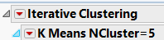
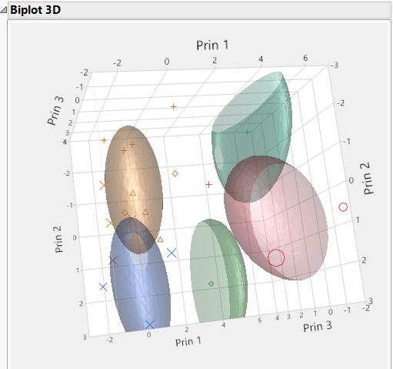
Choosing Best Model & Most Significant Variables
Key Attributes directly affecting predictions include Crime, Weapon, Premise, Age, Location & Sex
K-means cluster revealed 2 overlapping principal components
Decision tree to provide feedback to LA Police precinct
Neural model depicted a decent lift using 7 input variables
Decision tree; optimal split of 10
Naive Bayers showed best #’s with best misclassification rate
Time series supplemental only for predicting next 12 months

Slide 39
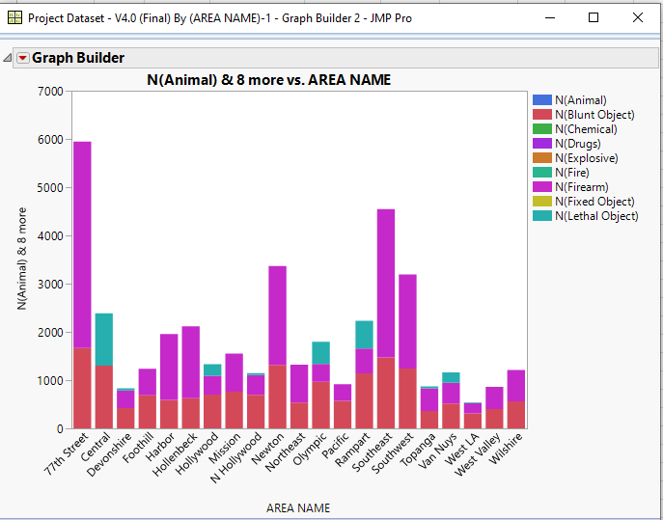
Results Obtained & Trade-offs Between Complexity & Accuracy
Most prevalent causes of crimes are drugs,blunt objects and lethal objects
77th area has the most occurences
Lowest crime rate of 2020 predicted for March
Trade off to bucket weapons
Previous data not meaningful
Categorical changed to numerical
Highest crime rate predicted to be in January of 2020
Data shows violent crime hot spots
Accuracy/complexity tradeoffs ??

Slide 40
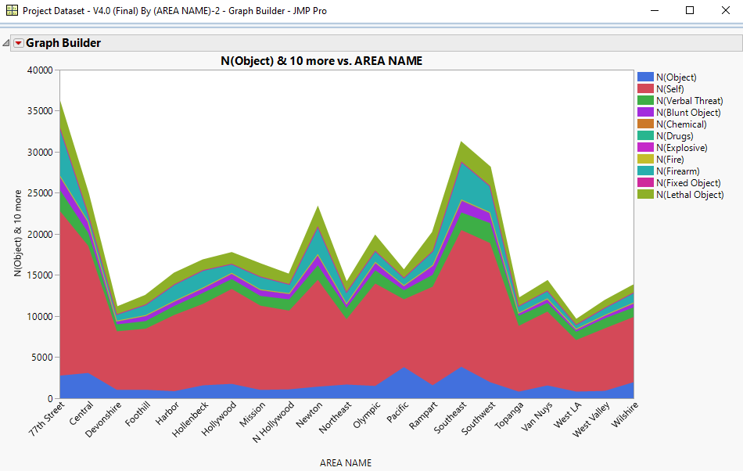
Other Models (as slide in appendix)
Time series modeling (supplemental & limited by historical)
Batch & creating cluster groups & subgroup
Precinct areas explored in models
Parallel plots
Decision tree
Ward clustering method

Slide 41
Heat map of Crimes

Slide 42
Crime by Year and Area

Slide 43
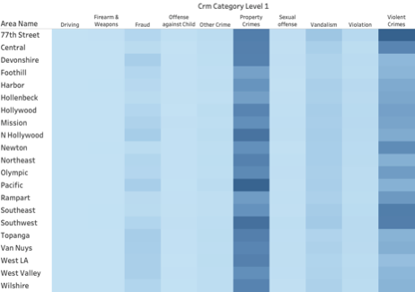
Crime Category by Area

Slide 44
4 Component of Analysis
Exploratory Analysis
Clustering to Identify Crime Hotspots
Time Series Analysis to predict number of crimes in next 12 months (supplemental)
Classifying if a crime is committed by a Juvenile (based on solved crimes):
This classification can help the police department in deciding to investigate possible juvenile subjects for unsolved crimes.

Slide 45
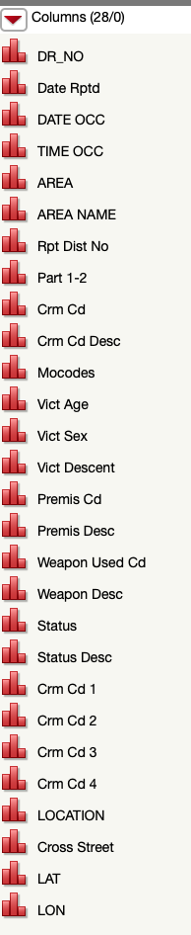
Initial Analysis
A lot of repetitive data
Room to simplify data
Columns can be bucketed
Data within column can be bucketed
Some columns had the wrong data type and modeling type

Slide 46
Interesting Observations
Discovered variability in multiple locations of Los Angeles
No Structural breaks in time series process
Does adding confidence intervals increase uncertainty ?
Bias in data considered to be inconclusive
Males in mid-twenties carry a higher weight in the forecasting model.
Exploration of data revealed a RMSE of 6.04 (>.5 is related to a poor predictive model or not significant) see the below figure (Remove this ?)

Slide 47
Challenges in Data Preparation
Drop area code & use area name
Plug Crm codes into multiple categories
Segmentation of part 1 & part 2 crime categories
Park usefulness of MOCode in predictive power for later
Transform & Normalize data
Exclude redundant data columns
Data completeness for discovery
Difficult to identify human/machine input errors
Is the data truly harmonized to analyze and make informed business decisions?
Uncovering interesting & useful facts

Slide 48
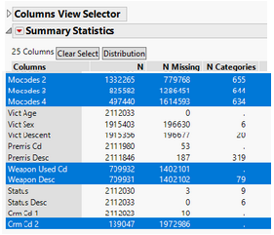
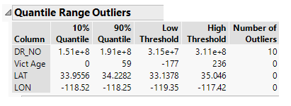
Handling Changes & Tools/Techniques Used
Identify missing data and outliers
Increase continuous variables
By creating summary data
Combine & bucket categories (sex,weapons)
Exclude data before 2015
Create summary data & run predictions
Input variables into multivariate
Find principal components
Remove location & cross street columns
Summary Statistics by grouping columns

Slide 49
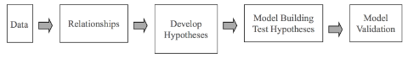
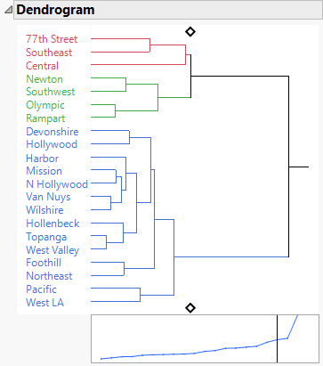
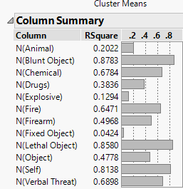
Models Built
Hierarchical clustering & visualizing in dendrogram (below)
Summarize the data by area for example
Take count of all categories in individual columns
Created validation column .7/.2/.1 (2015-2019)
Neural Model NTanH(3)
Time series
Decision tree

Slide 50
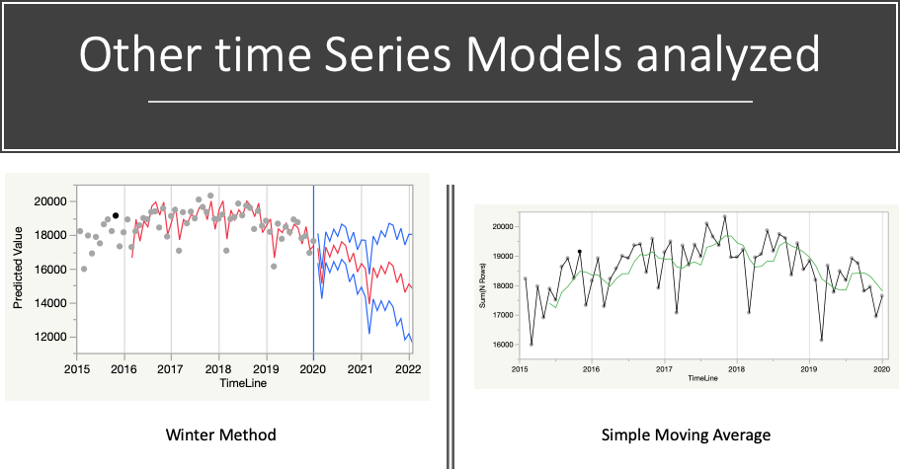

Slide 51
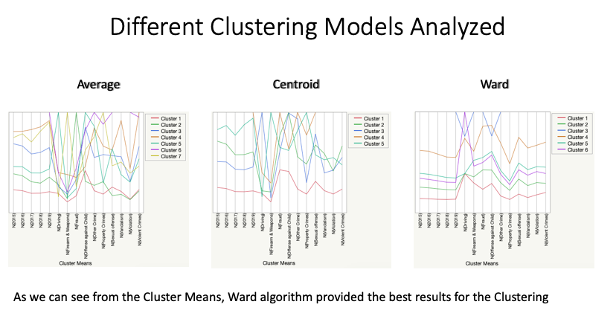

Slide 52
Links
MO Codes Numericals
Uniform Crime Reporting Handbook
UCR Reporting vs Compstat Reporting

